Slide 1
English in rhymes!

Slide 2
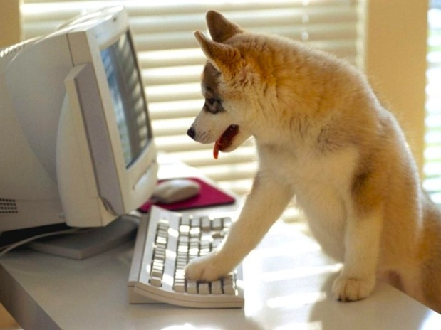
Part 1
Try to guess the English word to the Russian rhyme:
Ex :
У меня живет бульдог,
А собака - это
dog

Slide 3
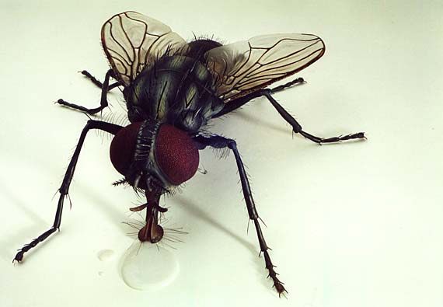
Part 1.
Катя в баночке закрыла
Гусеницу -
caterpillar.
Ты летай, летай, летай!
Муха по английский -
fly.

Slide 4
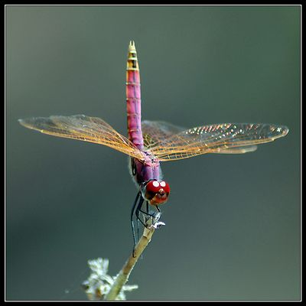
Part 1.
Стрекозу, дружок, поймай!
Стрекоза -
a dragon-fly
Следит за муравьями Брэнд
А муравей иначе -
ant.

Slide 5
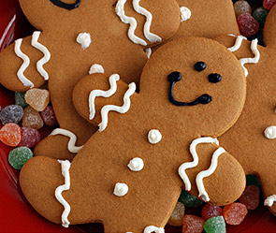
Part 1.
Клубнику быстро собери!
Клубника - это
strawberry
Я люблю ириски
И печенье -
biscuit

Slide 6
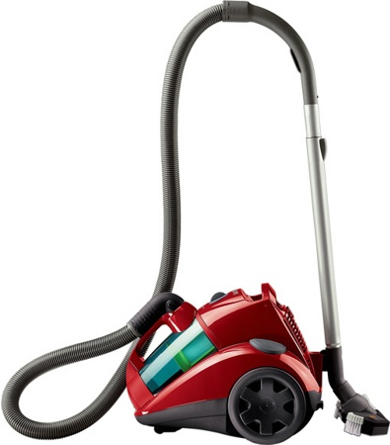
Part 1.
Все едят орешки.
Слышен звук: « Хрум-брум».
Если будет мусор,
Нужен веник -
broom
Что-то пылесос заклинил.
Пылесос -
a vacuum cleaner

Slide 7
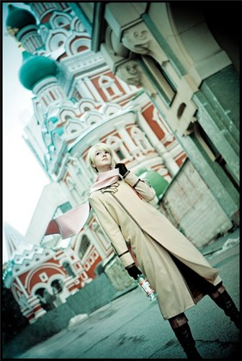
Part 1.
«Я из России»,
- скажет Саша.
А по-английски:
“ I’m from Russia ”
Когда не понимаю,
Я молча не стою.
…..
Всегда говорю.
-“ I don’t understand you!”

Slide 8
Part 2.
Try to make verse with the words:
1. Knee
2. Teeth
3. Fog
4. Pine
5. Squirrel

Slide 9
Part 2.
В колене ногу ты согни,
Колено по-английски: Knee
Что же? Что же ты молчишь?
Чищу зубы. Зубы – teeth.
Ни гор не вижу ни дорог
Кругом туман, иначе – fog!
Сосновый бор – чудесный край
Сосну мы называем – pine!
По деревьям кто-то прыгал
Оказалось , белка – squirrel!

Slide 10
Guess the song!
Part 3.
In the town where I was born
Lived a man who sailed to sea
And he told us of his life
So we sailed up to the sun
Till we found the sea of green
And we lived beneath the waves
And our friends are all on board
Many more of them live next door
And the band begins to play
As we live a life of ease
Everyone of us has all we need
Sky of blue and sea of green

Slide 11
Guess the song!
Part 3.
I've been cheated by you since I don't know when So I made up my mind, it must come to an end Look at me now, will I ever learn? I don't know how but I suddenly lose control There's a fire within my soul Just one look and I can hear a bell ring One more look and I forget everything, o-o-o-oh I've been angry and sad about the things that you do I can't count all the times that I've told you we're through And when you go, when you slam the door I think you know that you won't be away too long You know that I'm not that strong. Just one look and I can hear a bell ring One more look and I forget everything, o-o-o-oh

Slide 12
Guess the song!
Этап 3.
A goddess on a mountain top Was Burning like a silver flame A summit of beauty and love And Venus was her name. Her weapons were her crystal eyes Making every man mad, Black as the dark night she was Got what no one else had.

